Slide 1
Managing Files and Directories
Create and Edit Text Files
Search for Files
Perform Operations on Files and Directories
Process Text Files
Manipulate File Output

Slide 2

Topic A: Create and Edit Text Files
Exam Objectives:
2.3 Given a scenario, create, modify, and redirect files.

Slide 3
Text Editors
An application that enables you to view, create, or modify the contents of text files.
Used to edit a variety of text-based files.
Many types of editors are available in Linux.
Don't always support same formatting options as word processors.
Can work in CLI or GUI.
Have different modes of operation.
Many configuration components in Linux are text files.
You'll configure most of these components using text editors.
Being comfortable with text editors is essential.

Slide 4
Common Editors
vi
Vim
Emacs
gVim
gedit
GNU nano

Slide 5
Vim (Slide 1 of 2)
An extended version of the vi editor.
Implements text-based interface for advanced text editing.
Favored by many sysadmins and developers.
Efficient and highly customizable.
Includes:
Text completion.
Syntax highlighting.
Spell checking.
Many more features.

Slide 6
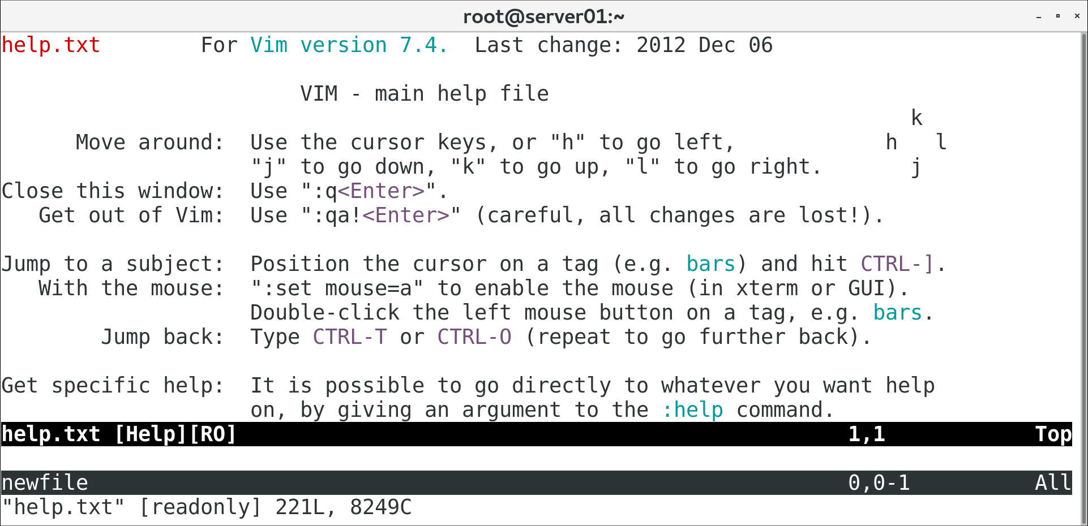
Vim (Slide 2 of 2)

Slide 7
The vim Command
Invokes Vim text editor.
vi redirects to Vim.
Without an argument, command opens welcome screen.
Use vim {file name} syntax to open a file.
If no file exists, Vim creates one with that name and opens it.
Supports multiple files opened simultaneously.

Slide 8
Vim Modes
Mode | Enables Users To
Insert | Insert text by typing.
Execute | Execute commands within the editor.
Command | Perform different editing actions using single keystrokes.
Visual | Highlight or select text for copying, deleting, etc.

Slide 9
Switch Modes (Slide 1 of 2)
Key | Function
i | Switches to insert mode and inserts text to left of cursor.
A | Switches to insert mode and adds text at end of line.
I | Switches to insert mode and inserts text at beginning of line.
o | Switches to insert mode and inserts text on new line below cursor.
O | Switches to insert mode and inserts text on new line above cursor.
v | Switches to visual mode to enable selection, one character at a time.
V | Switches to visual mode to enable selection, one line at a time.
: | Switches to execute mode to enable users to enter commands.
Esc | Returns to command mode.
Notes:
Teaching Tip: Consider emphasizing some of the most important keys.

Slide 10
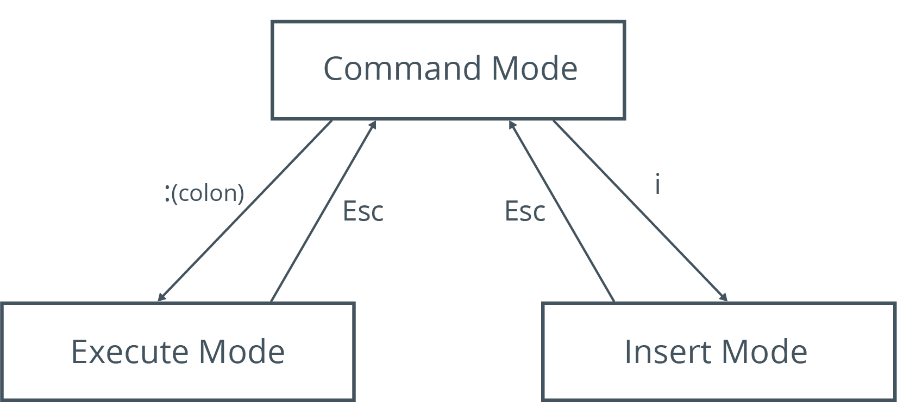
Switch Modes (Slide 2 of 2)

Slide 11
Execute Mode Commands
Command | Function
:w {file name} | Saves file with specified name.
:q | Quits when no changes have been made after last save.
:q! | Quits, ignoring changes made.
:qa | Quits multiple files.
:wq | Saves current file and quits.
:e! | Reverts to last saved format without closing file.
:!{any Linux command} | Executes command and displays results in Vim.
:help | Opens Vim's built-in help documentation.
Notes:
Teaching Tip: Students have used some of these commands in prior lessons.

Slide 12
Motions (Slide 1 of 2)
Single-key shortcuts that are used to navigate through files in command mode.
Navigation Key | Used To
h | Move left one character.
j | Move down one line.
k | Move up one line.
l | Move right one character.
^ | Move to the beginning of the current line.
Notes:
Teaching Tip: Consider emphasizing some of the most important motions.

Slide 13
Motions (Slide 2 of 2)
Navigation Key | Used To
$ | Move to the end of the current line.
w | Move to the next word.
b | Move to the previous word.
e | Move to the end of the current word or to the end of the next word.
Shift+L | Move the cursor to the bottom of the screen.
Shift+H | Move the cursor to the first line of the screen.
(Line #) Shift+G | Move the cursor to the specified line number.
gg | Move the cursor to the first line of the file.
Shift+G | Move the cursor to the last line of the file.

Slide 14
Editing Operators (Slide 1 of 2)
Keystrokes that can quickly manipulate text in a text editor.
Editing Operator | Used To
x | Delete character selected by cursor.
d | Delete text.
dd | Delete current line.
p | Paste text on line below cursor.
P | Paste text on line above cursor.
/{text string} | Search through document for specified text.
?{text string} | Search backward through document for specified text.

Slide 15
Editing Operators (Slide 2 of 2)
Editing Operator | Used To
y | Copy text.
yy | Copy line above cursor.
c{range of lines}c | Begin a change in specified range.
u | Undo latest change.
U | Undo all changes on current line.
ZZ | Write file only if changes were made, then quit Vim.

Slide 16
GNU nano (Slide 1 of 2)
A small, user-friendly text editor that evolved from the Pico text editor created for Unix-like systems.
Vim is powerful, but not user-friendly.
Multiple modes, bare interface, some unintuitive commands, etc.
GNU nano is more visually helpful.
Displays command shortcuts at bottom of screen.
GNU nano has fewer commands, and commands share a common prefix.
GNU nano doesn't have modes.
GNU nano lacks some Vim features and is less powerful.

Slide 17
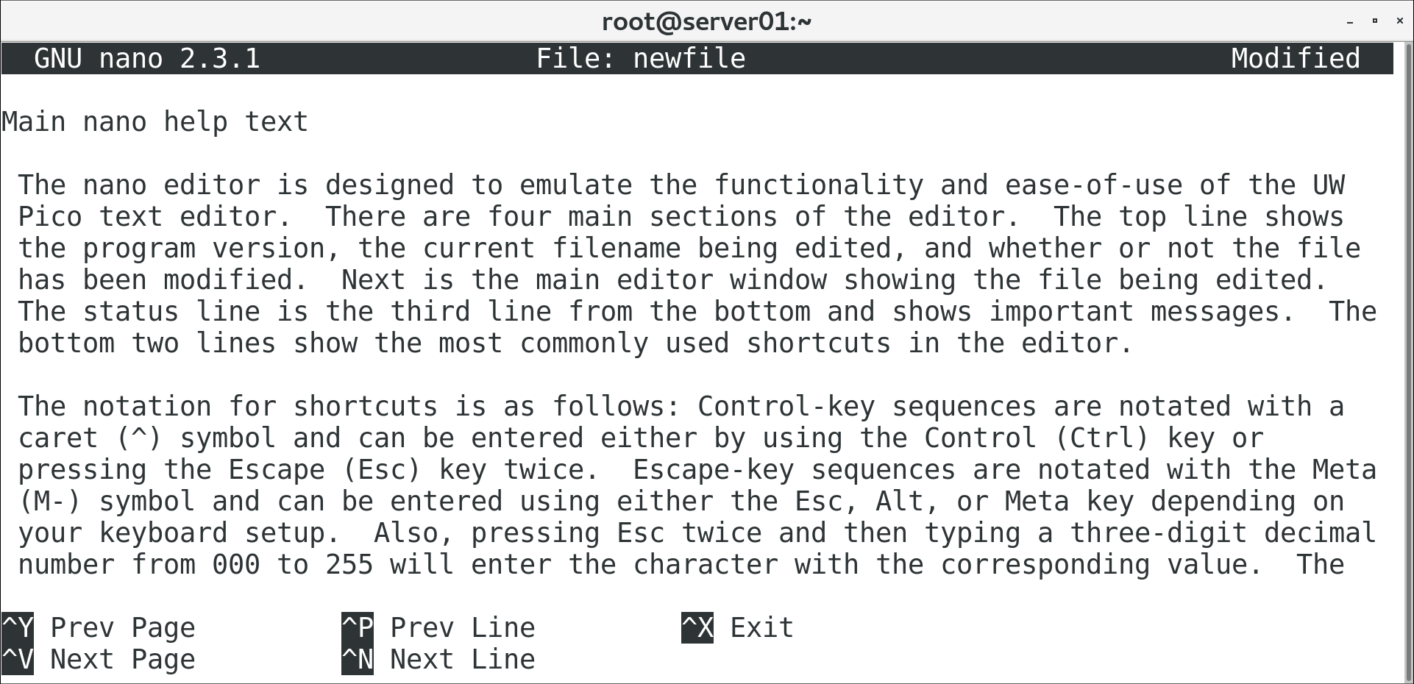
GNU nano (Slide 2 of 2)

Slide 18
The nano Command
Invokes GNU nano text editor.
Without an argument, opens a new file for editing.
You can save and specify name later.
Use nano {file name} syntax to open a file.
If no file exists, nano creates one with that name and opens it.
Supports opening multiple files simultaneously.
Files opened in different "buffers" you can switch between.

Slide 19
nano Shortcuts
Shortcut | Used To
Ctrl+G | Open nano to help screen.
Ctrl+X | Exit nano or close current buffer.
Ctrl+O | Save currently open file.
Ctrl+J | Justify current paragraph.
Ctrl+R | Insert another file into the current one.
Ctrl+W | Search the file.
Ctrl+K | Cut the currently selected line.
Ctrl+U | Paste the line that was cut.
Ctrl+C | Display the cursor's position.

Slide 20
The gedit Text Editor (Slide 1 of 2)
The default GUI text editor used in GNOME desktop environments.
Unlike Vim and nano, gedit has a menu-based design.
Easy to work with.
Features syntax highlighting, spell checking, customization, etc.
Not as powerful as Vim, but still useful if desktop is installed.
Can be launched from desktop or through gedit command.
Similar syntax to vim and nano commands.

Slide 21
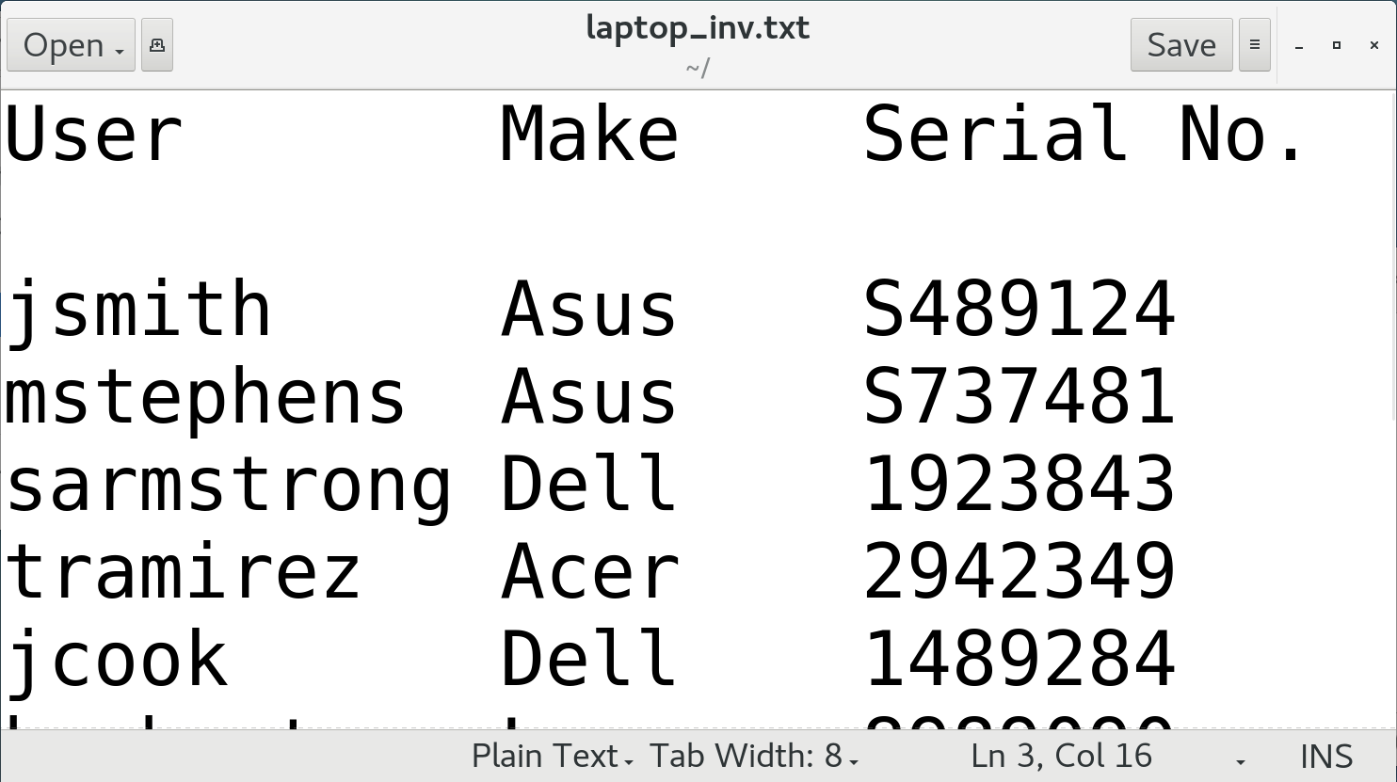
The gedit Text Editor (Slide 2 of 2)

Slide 22
Discussing Creating and Editing Text Files

Slide 23
Activity 5-1: Discussing Creating and Editing Text Files
You're editing a file in Vim and you realize that you've made several errors and decide to start over with your editing. How do you leave the file without saving any changes that you've made?
ANSWER:
Press Esc to enter command mode and then enter :q!

Slide 24
Activity 5-1: Discussing Creating and Editing Text Files
You want to create a shell script using Vim. You enter Vim but can't type any letters. What do you need to do before you can begin typing?
ANSWER:
You have to press i for insert mode and then begin typing text.

Slide 25
Activity 5-1: Discussing Creating and Editing Text Files
You've created a script in Vim and note that you haven't entered any instructions or documentation into the file. Standard practice is to add your comments above the line of code that you're describing. How do you open a new line above the one you're currently typing on?
ANSWER:
Press Esc to enter command mode and then press O.

Slide 26
Activity 5-1: Discussing Creating and Editing Text Files
How do you copy and paste text in the Vim editor?
ANSWER:
Press Esc to enter command mode, then type y for yank (copy) and then p for paste.

Slide 27
Activity 5-1: Discussing Creating and Editing Text Files
For text file editing in Linux, you have options other than Vim. Name one graphical editor and one other command-line interface (CLI) editor that you might use instead of Vim.
ANSWER:
You can use gedit for the graphical editor and GNU nano for the CLI editor.

Slide 28
Activity: Creating Text Files
You've been asked to start a list of required software.
You'll create a text file and begin entering names.
You'll save your work and pick up with it later.
Notes:
Teaching Tip: This activity should be review for students, as they've worked with Vim earlier in the course.
Teaching Tip: If students are curious, Eclipse is an integrated development environment (IDE) and OpenVAS is a vulnerability scanner.

Slide 29
Activity: Editing Text Files
A colleague has filled out the software list.
You want to check it for errors and correct any.
You'll edit in both Vim and GNU nano to get a feel for them.

Slide 30
Topic B: Search for Files
Exam Objectives:
2.3 Given a scenario, create, modify, and redirect files.

Slide 31
The locate Command (Slide 1 of 2)
Performs a quick search for specified string in file names/paths.
File names/paths are stored in mlocate database.
Must be updated regularly for search to be effective.
Results may be restricted based on access permissions.

Slide 32
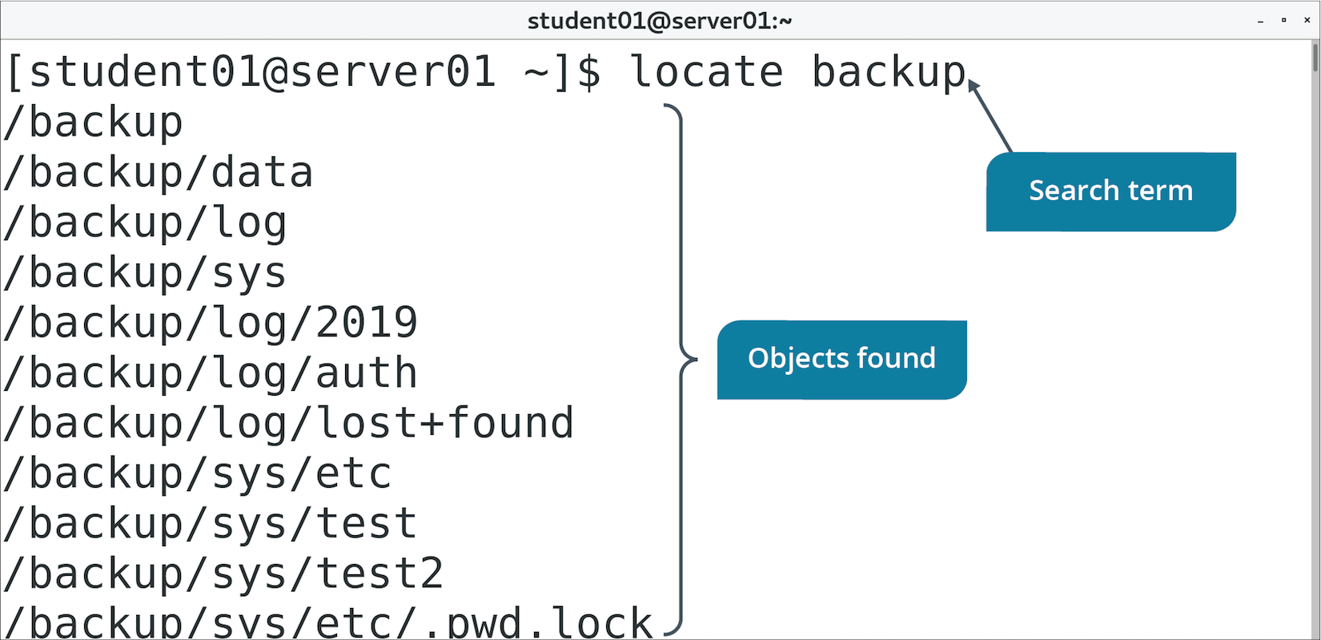
The locate Command (Slide 2 of 2)

Slide 33
The find Command
Search specific locations for files and directories using search criteria.
Recursively searches directory structure.
You can perform one or more actions on files found.
Use -type to specify object type you're looking for.
Use -name to specify name of object you're looking for.

Slide 34
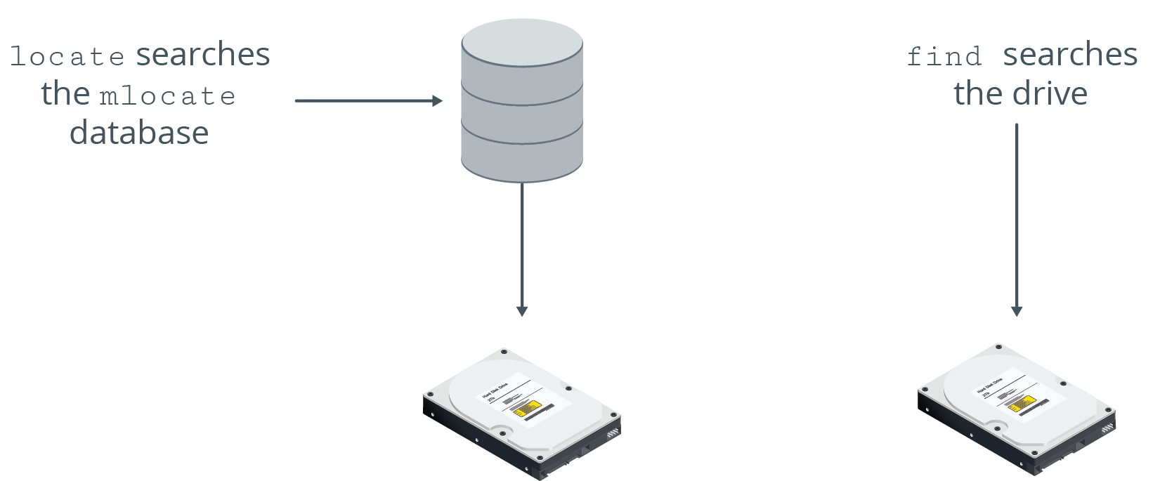
find vs. locate Commands

Slide 35
The which Command (Slide 1 of 2)
Displays complete path of specified command.
Searches directories assigned to PATH variable.
Example: which cat outputs /bin/cat
Useful if you need to locate where a program has been installed.
Useful for identifying which version of a command is running.
Command might have different binaries in different locations.

Slide 36
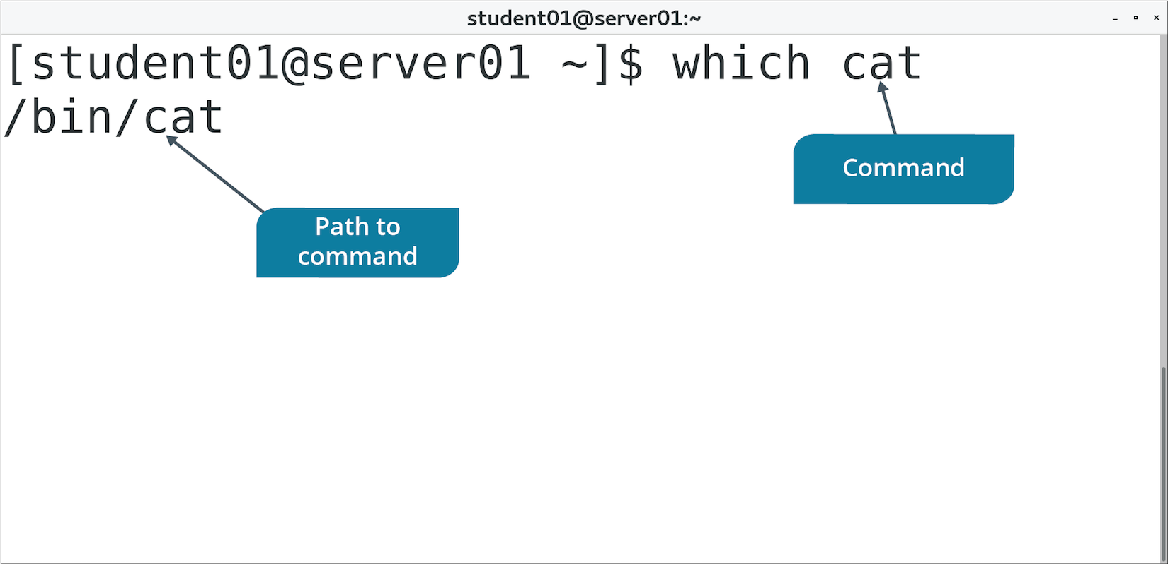
The which Command (Slide 2 of 2)

Slide 37
The whereis Command (Slide 1 of 2)
Displays various details associated with a command.
Example: whereis ls
Output: ls: /bin/ls /usr/share/man/man1/ls.1.gz /usr/share/man/man1p/ls.1p.gz
/bin/ls indicates location of ls command.
The rest indicates location of ls man pages.

Slide 38
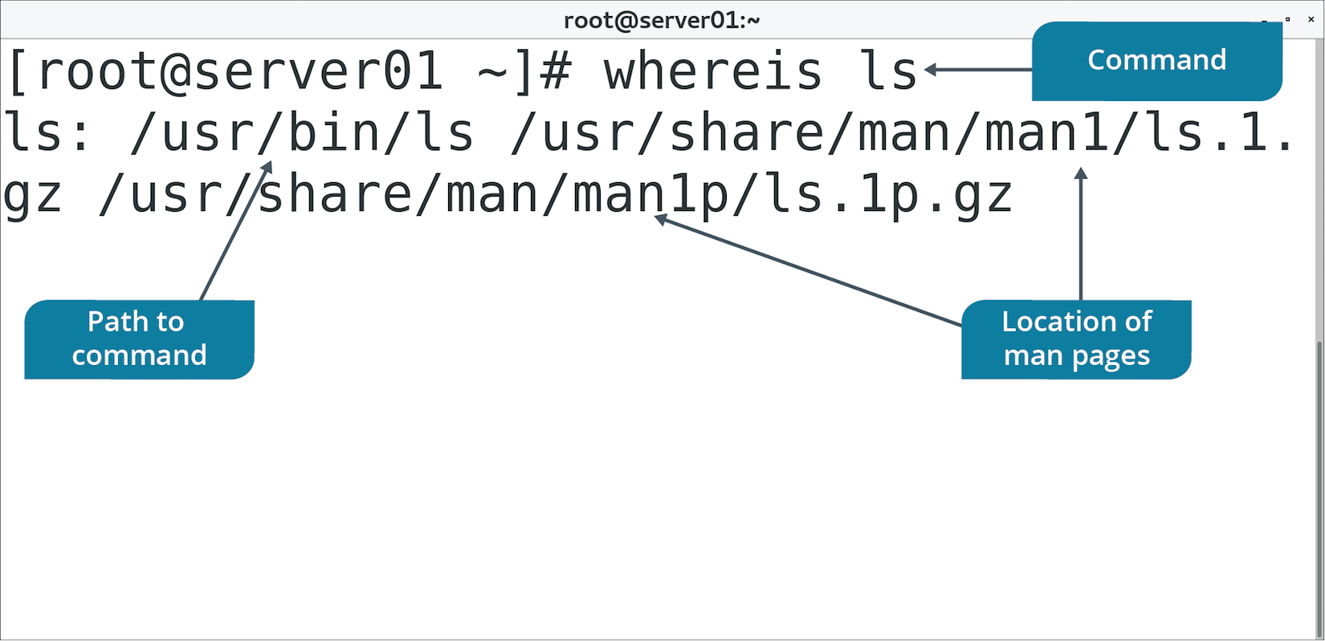
The whereis Command (Slide 2 of 2)

Slide 39
Discussing Searching for Files

Slide 40
Activity 5-4: Discussing Searching for Files
You tried using locate to find README files on your new Linux system but quickly realized that it wasn't installed at build time. After installation, you tried using locate to find README files, but again the command has failed to find anything. You discover that for locate to work, you must build the mlocate database. Which command can you run to build the mlocate database?
ANSWER:
sudo updatedb

Slide 41
Activity 5-4: Discussing Searching for Files
You tried using locate to find the cat command but locate searches for strings and returned more than 2,000 hits. You need something more efficient for searching for a specific file, especially commands. Which command can you run to selectively find the cat command?
ANSWER:
which cat

Slide 42
Activity 5-4: Discussing Searching for Files
You and other junior Linux administrators have noticed that some basic commands don't have man pages associated with them. You would like to know which ones do. One of the other administrators told you about a command that would also list the man pages for a command search. To which command was he referring?
ANSWER:
whereis

Slide 43
Activity 5-4: Discussing Searching for Files
The find command is one of the most powerful in a system administrator's toolbox. What does the following find command do? find / -name "carbon*" –print
ANSWER:
This find command searches from the root (/) directory and all subdirectories for any files beginning with the word "carbon" and their locations.

Slide 44
Activity 5-4: Discussing Searching for Files
Which of the search commands at your disposal would you use to locate a user's lost files, knowing that the user has access to dozens of directories and subdirectories as a member of several organizational groups?
ANSWER:
The find command can locate files by owner or group, plus it displays the absolute path location.

Slide 45
Activity: Searching for Files
You need to ensure logs are functioning as expected.
Crucial to diagnosing problems.
You'll start by searching for where logs are stored.
Then you'll search for logs meeting requirements:
Above a certain size.
Updated recently.

Slide 46
Topic C: Perform Operations on Files and Directories
Exam Objectives:
2.3 Given a scenario, create, modify, and redirect files.
3.1 Given a scenario, apply or acquire the appropriate user and/or group permissions and ownership.

Slide 47
The cat Command
Displays, combines, and creates text files.
Usually used to display contents of small text files.
Option | Used To
-n | Precede output with respective line number.
-b | Number lines, excluding blank lines.
-s | Suppress output of repeated empty lines.
-v | Display non-printing characters as visible characters.
-e | Print $ at the end of each line.
-t | Print tabs as ^I and form feeds as ^L

Slide 48
The head and tail Commands (Slide 1 of 2)
head displays first 10 lines of a file.
tail displays last 10 lines of a file.
Useful when you only need to see beginning or end of a file.
Example: Check only 10 most recent log entries using tail

Slide 49
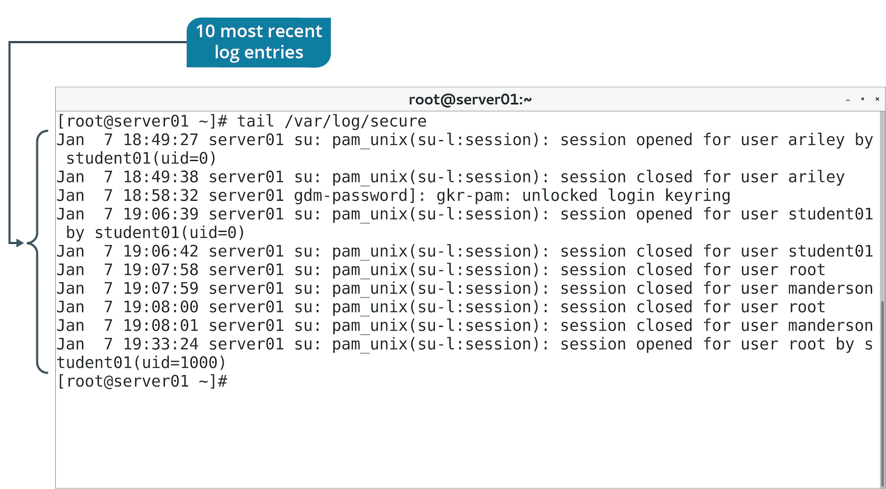
The head and tail Commands (Slide 2 of 2)

Slide 50
The less and more Commands (Slide 1 of 2)
Both are used to page through lengthy text files.
less has additional features; newer versions of more added some as well.
less is preferred.

Slide 51
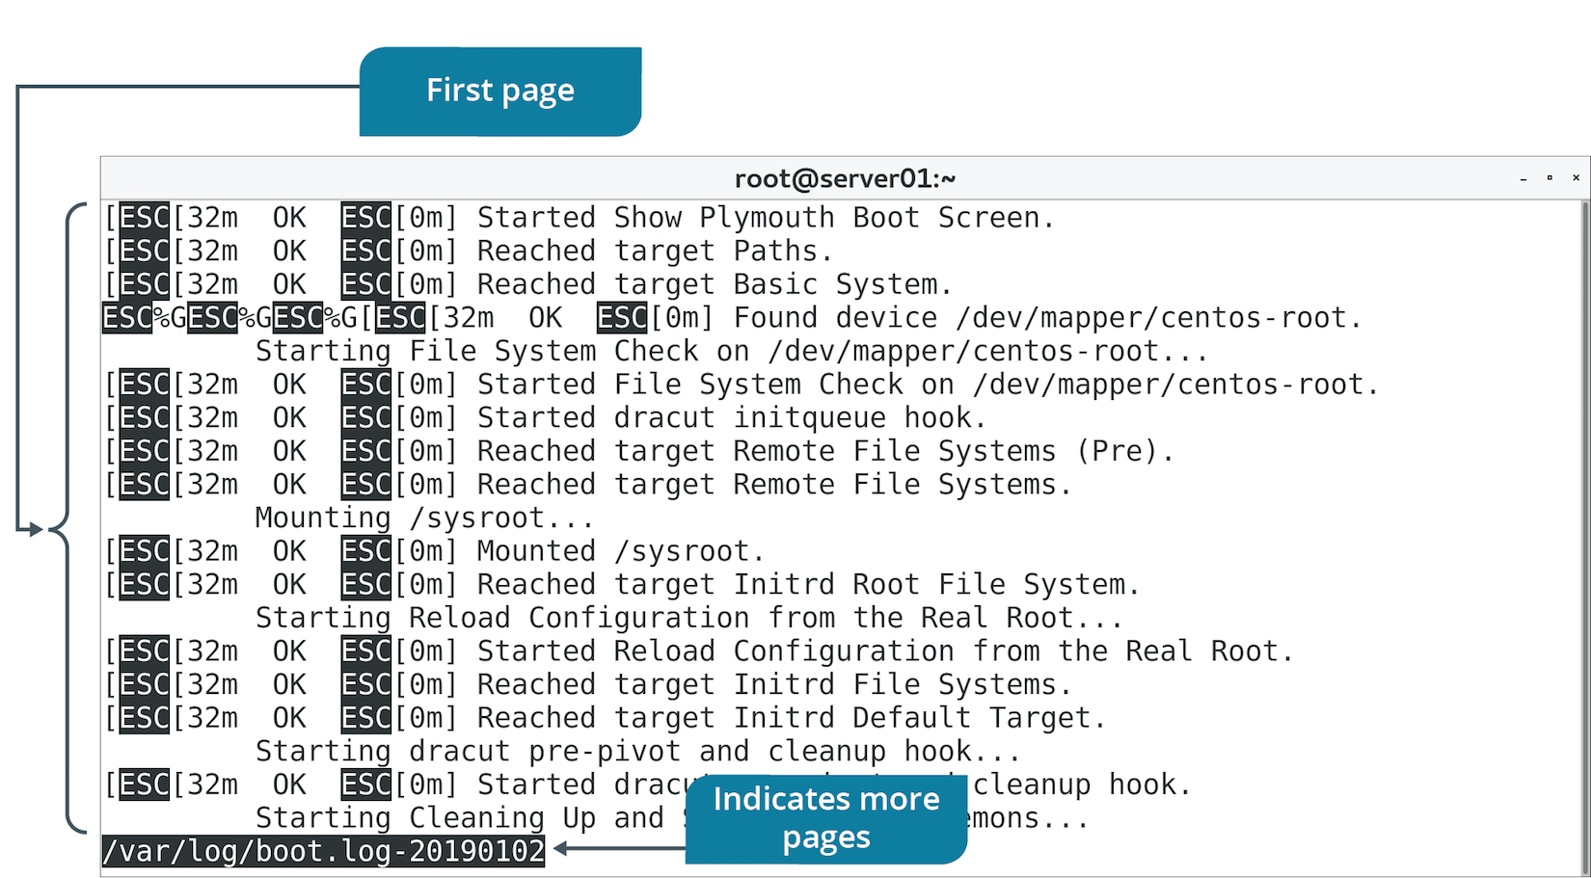
The less and more Commands (Slide 2 of 2)

Slide 52
The cp Command
Enables you to copy and then paste files or directories.
Initial object is left where it is.
Duplicate object is created in location you specify.
Must use -R option to copy directories recursively.

Slide 53
The mv Command
Moves files/directories.
Similar to cp, but doesn’t leave initial object intact.
More like a cut and paste operation.
Also used to rename files/directories.
No dedicated rename command in Bash.
"Moving" object to new name destination essentially renames it.

Slide 54
The touch Command
Changes time of access/modification time of file.
Changes to current time or with time provided in argument.
Also used to create blank files.
File name is supplied in argument.
Useful for testing purposes.

Slide 55
The rm Command
Removes files/directories.
Must use -R option to recursively remove:
Files
Subdirectories
Parent directory

Slide 56
The ls Command
Lists contents of directories, permissions of files/directories, and more.
Option | Used To
-l | Display long list including permissions, owner, group, size, etc.
-F | Display nature of file (executable, directory, etc.).
-a | Display all files, including "hidden" files.
-R | Recursively display all subdirectories.
-d | Display info about symbolic links.
-L | Display all files including symbolic links.

Slide 57
The mkdir and rmdir Commands
mkdir creates directories.
You supply name of directory as argument.
rmdir removes blank directories only.
Must use rm -R to delete directories with contents.

Slide 58
Discussing Performing Operations on Files and Directories

Slide 59
Activity 5-6: Discussing Performing Operations on Files and Directories
Linux users use the cat command to print a file's contents to the screen, but the original purpose of cat is to concatenate or join the contents of two or more files together into a single file. You have files test.1 and test.2 that you want to combine into a single file, test.3. How can you accomplish this using cat?
ANSWER:
cat test.1 test.2 > test.3

Slide 60
Activity 5-6: Discussing Performing Operations on Files and Directories
As a system administrator, what application of the tail command comes to mind first for checking on system status or an application's status?
ANSWER:
Using tail on a log file to see the most recent entries should come to mind for checking the status of the system or an application.

Slide 61
Activity 5-6: Discussing Performing Operations on Files and Directories
There are two utilities that are good for paging through very long files with search capability. Both enable you to stop, proceed line-by-line, page-by-page, and to page up. Some administrators prefer one utility over the other because it has a few more options. What are these two utilities?
ANSWER:
more and less

Slide 62
Activity 5-6: Discussing Performing Operations on Files and Directories
Your manager asks you to copy all the files in the /opt directory to /backup for further inspection and analysis. Rather than copying every file and subdirectory manually, how can you copy /opt and all its contents to /backup with a single command?
ANSWER:
sudo cp -R /opt /backup —This command copies the /opt directory recursively to /backup

Slide 63
Activity 5-6: Discussing Performing Operations on Files and Directories
Diane Smith has left the company and you want to preserve her home directory, so you decide to rename it. How can you rename /home/dsmith to /home/dsmith.keep?
ANSWER:
mv /home/dsmith /home/dsmith.keep

Slide 64
Activity: Reading Files
One of your duties is to review logs.
Before diving into analysis, you'll need to select the best reader to use.
You'll use commands like cat and less to see which is most applicable and when.
Notes:
Teaching Tip: Students can press Ctrl+C if they want to stop all of the text from printing.

Slide 65
Activity: Manipulating Files and Directories
You need to move policy documents from HR workstation to a server.
More centrally located.
HR lead didn't do a good job organizing files.
Old policies mixed in with current ones.
Inconsistent naming.
All in aups folder.
You'll copy files to your home directory temporarily.
You'll keep active policies and delete old ones.
You'll rename aups to policies to be more general.
You'll add some placeholders for future policy files.

Slide 66
Topic D: Process Text Files
Exam Objectives:
2.3 Given a scenario, create, modify, and redirect files.

Slide 67
The echo Command (Slide 1 of 2)
Used to display line of text at the terminal.
Can also be used to write text to a file.
Uses redirection.

Slide 68
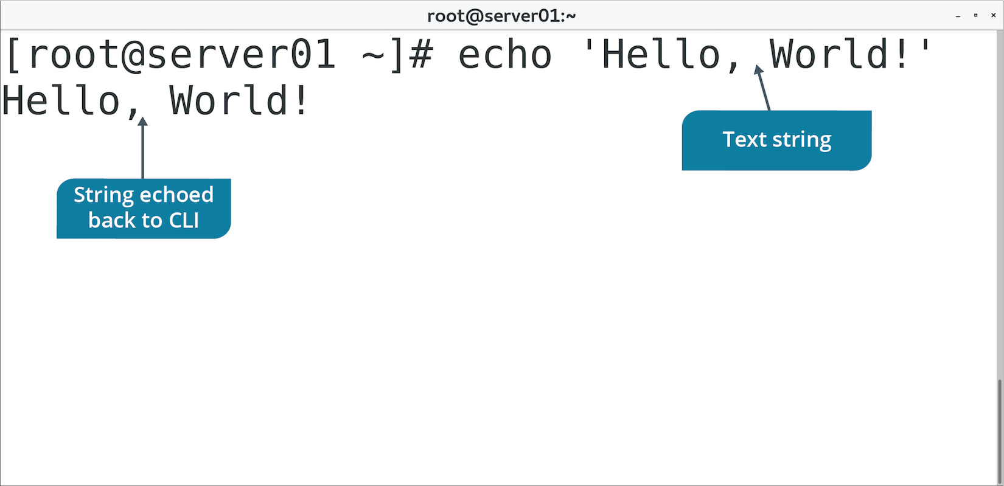
The echo Command (Slide 2 of 2)

Slide 69
The tr Command
Used to translate string of characters.
Usually used to change cases of letters.
Acts only on stream; can't change file contents directly.
Requires redirection.
Notes:
Teaching Tip: Redirection is discussed in the next topic.

Slide 70
The wc Command (Slide 1 of 2)
Used to count number of lines, words, and characters in a file.
With multiple files, wc displays counts for each file and total for all files.

Slide 71
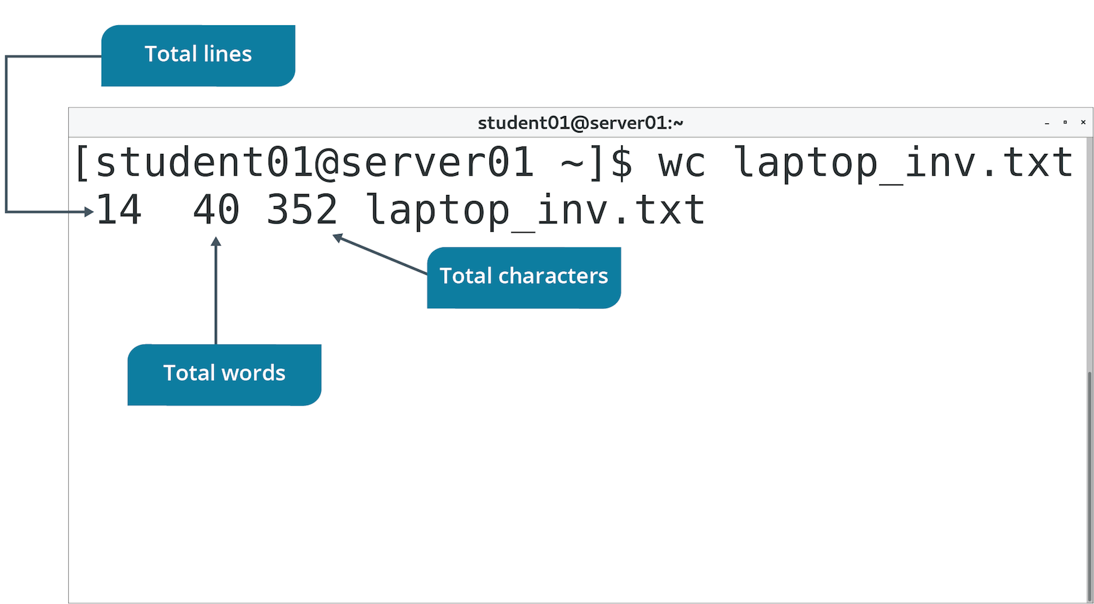
The wc Command (Slide 2 of 2)

Slide 72
The sort Command (Slide 1 of 2)
Arranges the lines in a file.
Option | Used To
-k{column numbers} | Specify field values.
-n | Compare and sort lines based on string numerical value.
-r | Sort fields in descending order.
-t{delimiter} | Separate one field from another.

Slide 73
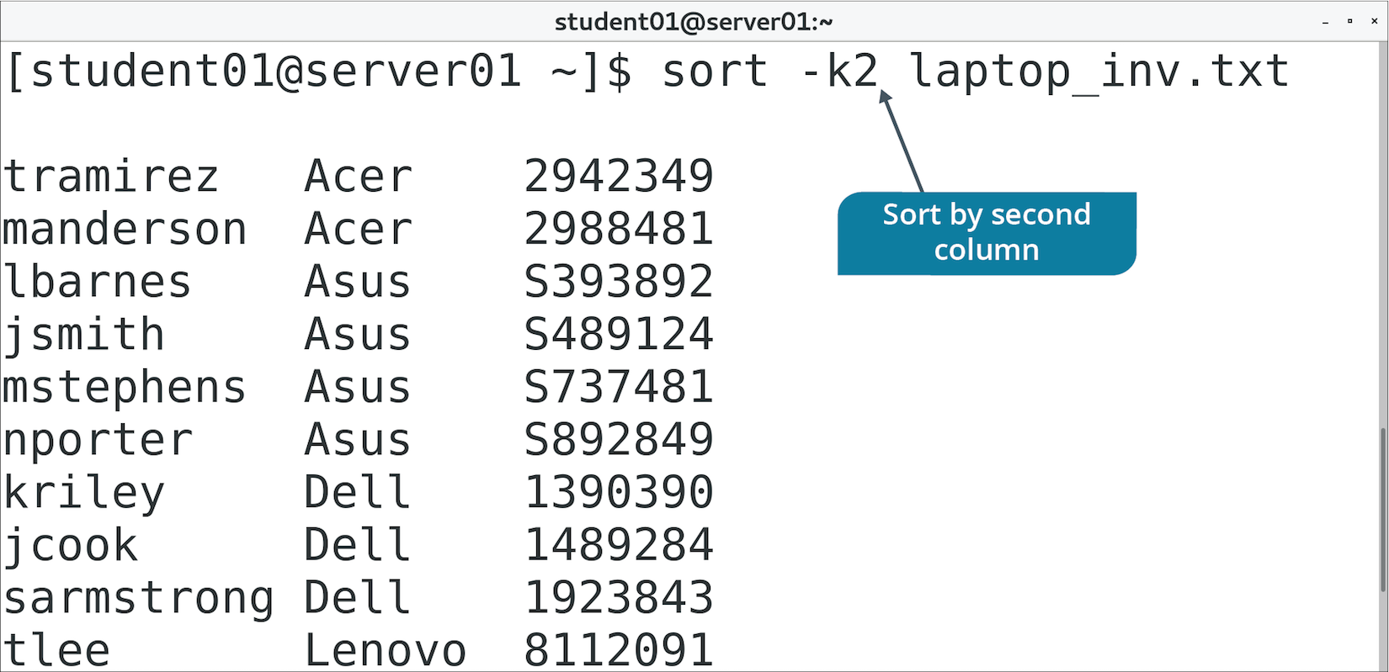
The sort Command (Slide 2 of 2)

Slide 74
The cut Command (Slide 1 of 2)
Extracts specified lines of text from a file.
Option | Used To
-c | Specify the number of the character to cut from each line.
-d{delimiter} | Separate one field from another.
-f{field numbers} | Specify field numbers to cut on as separated by delimiter.
-s | Suppress line if delimiter is not found.

Slide 75
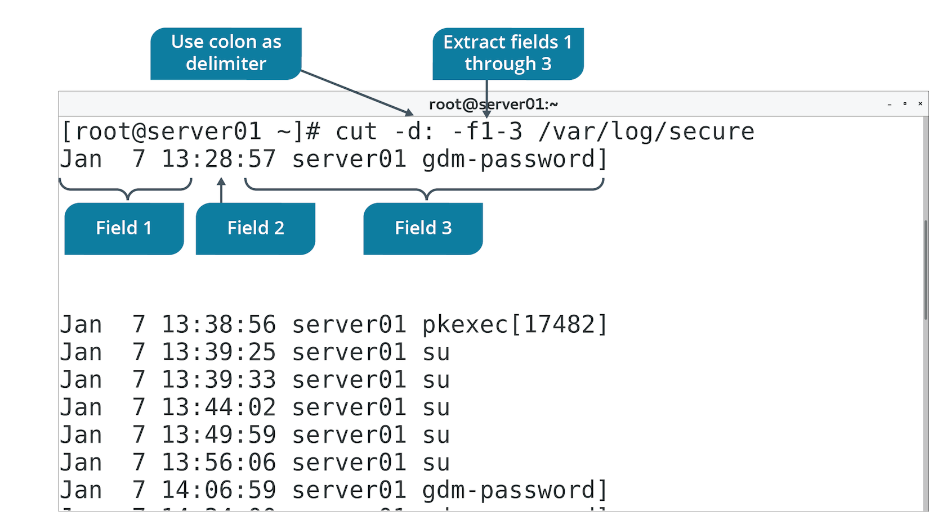
The cut Command (Slide 2 of 2)

Slide 76
The paste Command (Slide 1 of 2)
Used to merge lines from text files horizontally.
Each line of first file is a row in first column.
Each line of second file is a row in second column.
Default delimiter is a tab space; use -d option to specify another.
cities file:
New York
Tokyo
London
Lima
countries file:
United States
Japan
England
Peru

Slide 77
The paste Command (Slide 2 of 2)
Output of paste -d , cities countries
New York,United States
Tokyo,Japan
London,England
Lima,Peru

Slide 78
The diff Command (Slide 1 of 2)
Compares text files.
Displays two files and differences between them
Uses symbols to suggest how to change one file to make it identical to the other.
Each symbol has a special meaning.
< {line} means line should be removed from first file.
> {line} means line should be added from second file.
Also denotes line numbers for each file affected by deletion, addition, and changes.

Slide 79
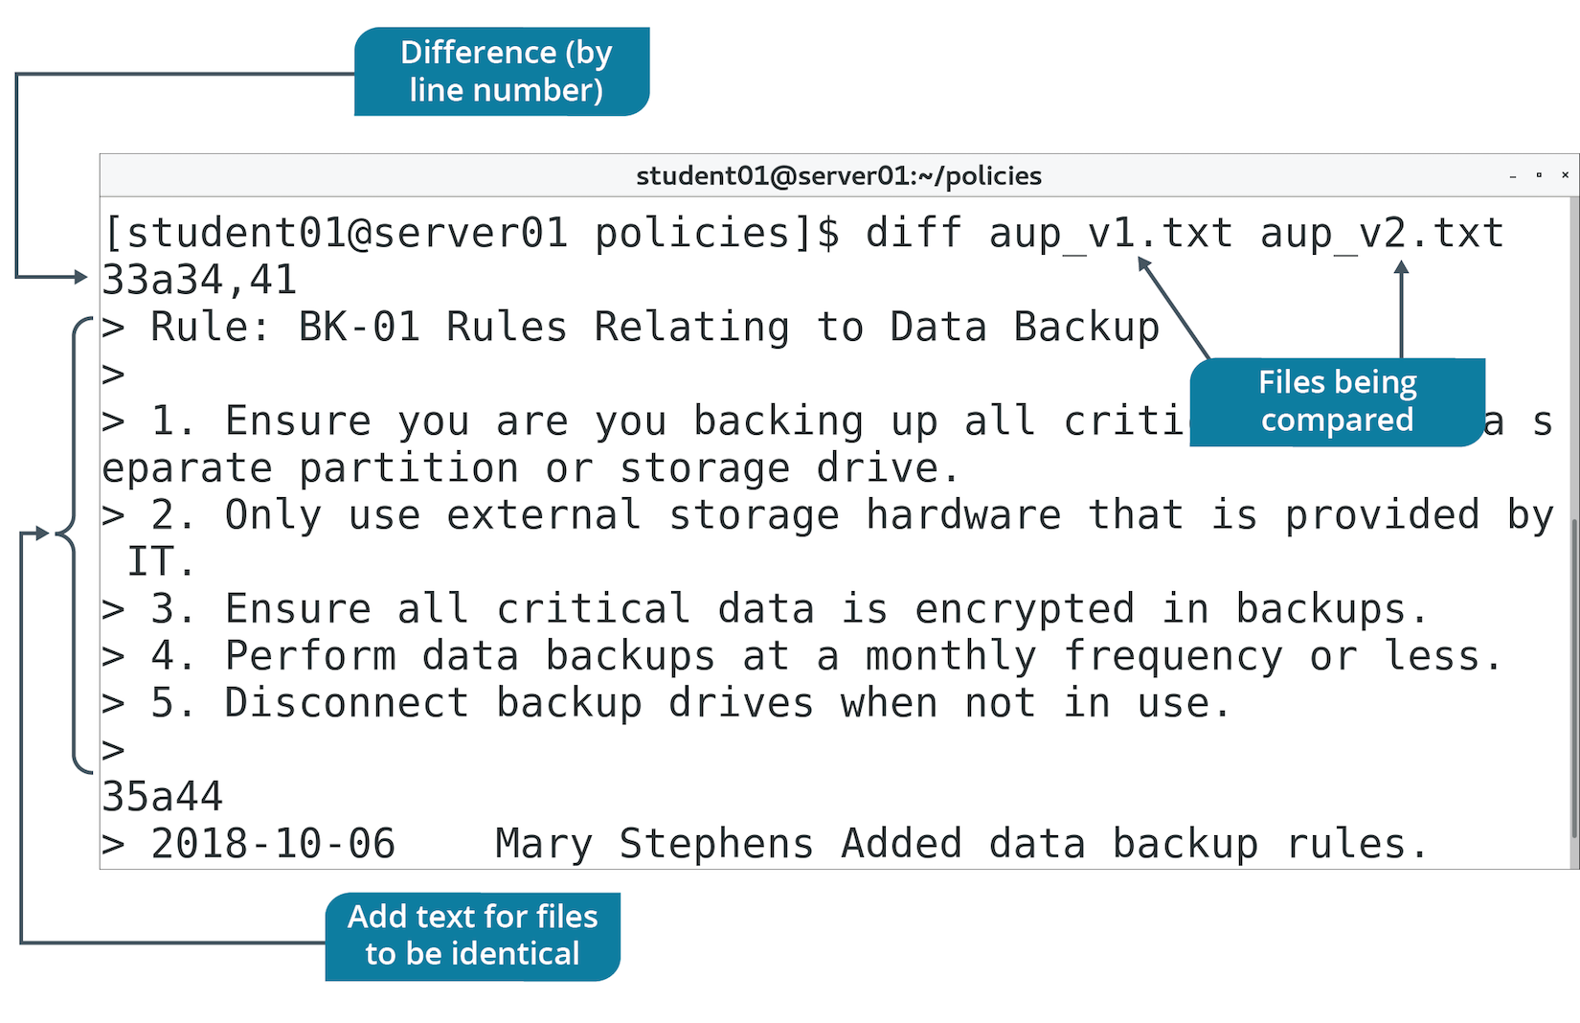
The diff Command (Slide 2 of 2)

Slide 80
The grep Command (Slide 1 of 2)
A search tool.
Not limited to finding file names.
Often used to search contents of files.
Output displays each line of file that matches your provided search pattern.
You can process and read contents pertinent to you.
Example: Retrieve login events of specific user.
Don't need to read entire file.
Don't need to step through a search in a text editor.
Use grep to print all the relevant lines.

Slide 81
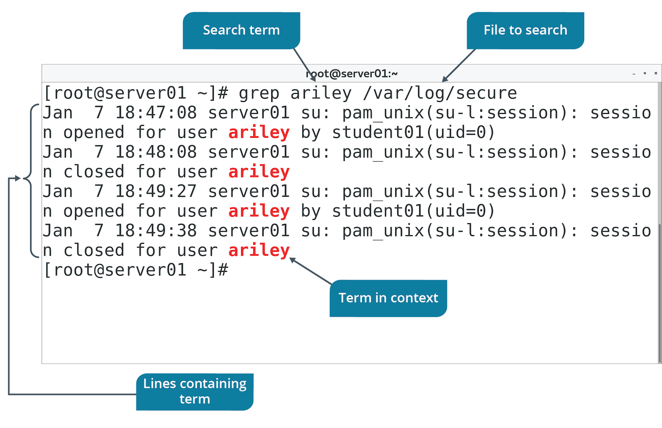
The grep Command (Slide 2 of 2)

Slide 82
The awk Command (Slide 1 of 2)
Performs pattern matching on files.
Based on AWK programming language.
Keyword is followed by pattern, action to perform, and file name.
Action is placed in curly braces.
Pattern and action should be inside single quotes.
Can be used from command line or execute as a script.
Can process files in a variety of ways:
Retrieve text matching pattern.
Delete text matching pattern.
Add text matching pattern.
Much more.

Slide 83
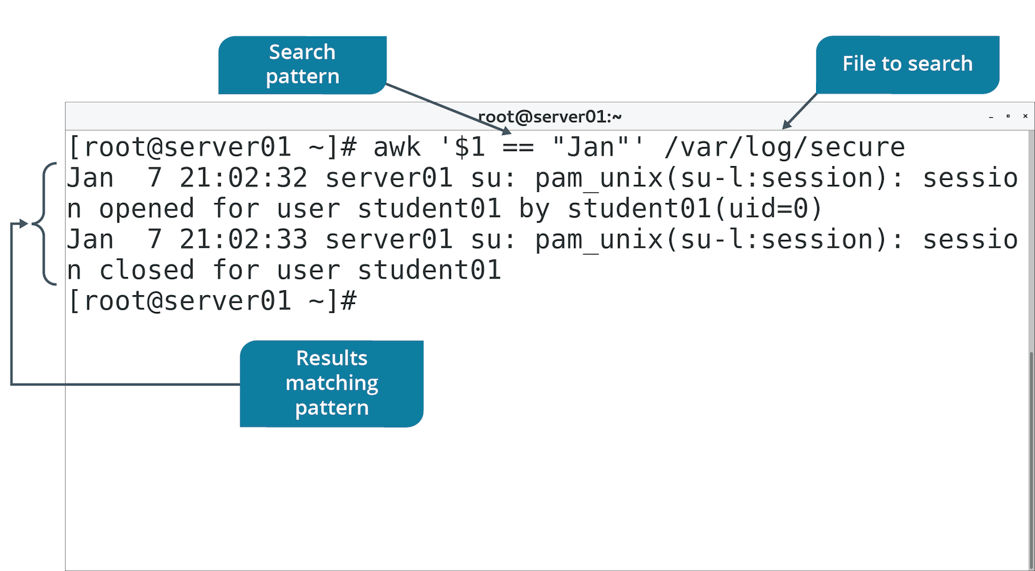
The awk Command (Slide 2 of 2)

Slide 84
The sed Command (Slide 1 of 3)
Stream editor used to modify text files according to various parameters.
Can also be used for global search and replace actions.

Slide 85
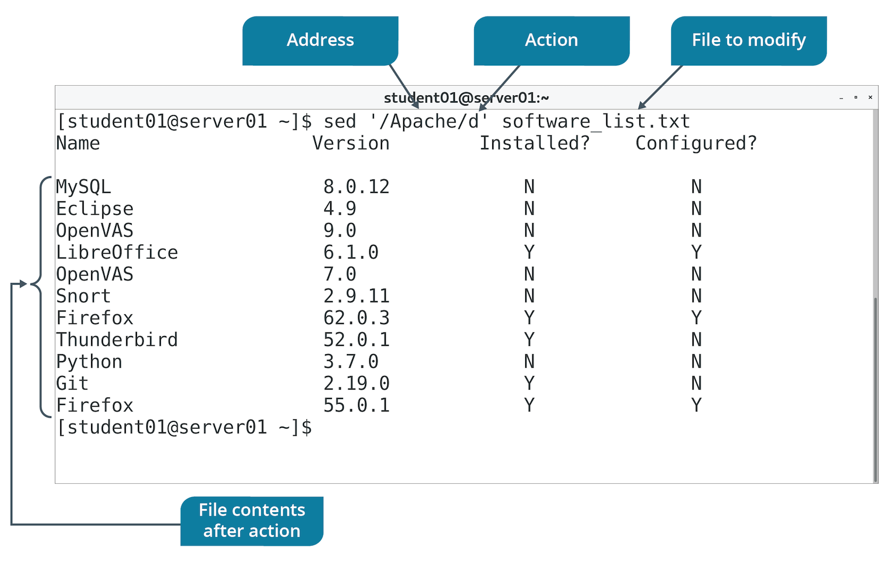
The sed Command (Slide 2 of 3)

Slide 86
The sed Command (Slide 2 of 3)
Option | Used To
d | Delete lines matching a pattern.
-n,p | Print only lines containing pattern.
s | Substitute first occurrence of string in file.
s,g | Globally substitute original string with replacement string for each occurrence.

Slide 87
The ln Command
Used to create a link to a file.
File name in one directory (link) points to file in another directory (target).
Link doesn't contain data, only reference to target.
Changes to link reflect in the target.
If you don't specify link name, it will be created in current working directory.

Slide 88
Types of Links
You can use ln to create hard or symbolic links.
Feature of file systems like ext2,3,4 and XFS.
Hard links:
Apply to files only, not directories.
File data has more than one location on file system.
If main file is deleted, data will be still available in link.
Cannot be created between files on different file systems.
Symbolic links:
Can be created between two file systems.
If main file/directory is deleted, content is lost.
Also known as soft links.

Slide 89
Discussing Processing Text Files

Slide 90
Activity 5-9: Discussing Processing Text Files
The echo command is a very powerful one indeed. It can be used in scripts or interactively at the command-line to do several different things. How can you use the echo command to display your name on the screen?
ANSWER:
echo "Bob Jones" —This command sends the output, Bob Jones, to the screen.

Slide 91
Activity 5-9: Discussing Processing Text Files
How would you use the printf command to display your name and address on different lines using a single command?
ANSWER:
printf "Bob Jones\n 222 Pine Street" —The \n sends a newline character to output and places the address on a second line. You can get very sophisticated with newline characters and file formatting so that screen text is easier to read.

Slide 92
Activity 5-9: Discussing Processing Text Files
You have two files that contain more than 100 lines of text each. You need to compare them because, while they're supposed to be similar, checking each one against the other is time-consuming. Fortunately, Linux has a utility to compare the two files. How can you compare file1.txt and file2.txt using this utility?
ANSWER:
diff file1.txt file2.txt

Slide 93
Activity 5-9: Discussing Processing Text Files
A user asks you to help him find a particular string ("audition") in a file, actors.txt. He can't seem to remember which actor he had auditioned for a commercial spot, and he needs to call her back. How can you find his actor using a simple command, rather than read the text file manually?
ANSWER:
grep audition actors.txt

Slide 94
Activity 5-9: Discussing Processing Text Files
You have a file that contains a very long list of activities (activities.txt) that were suggested by coworkers for things to do at the annual picnic. They are in no particular order, but you'd feel better if they were in alphabetical order, making them more readable. How can you rearrange the list into alphabetical order quickly?
ANSWER:
sort activities.txt

Slide 95
Activity: Processing Text Files
You want to begin analyzing documents.
Sort the software list to see what needs to be installed/configured.
What has changed from v1 to v2 of AUP.
Also need to perform some log analysis.
Identify failed logins.
Users may try to access resources they shouldn't.
Extract only relevant info from the log.
Notes:
Teaching Tip: Students will do more with grep in the next topic.

Slide 96
Activity: Linking Files
You want to organize your backup directory.
Create subdirectories, each one a category of log.
By type.
By year.
Logs will cross multiple categories.
Create links instead of copies.
Easier to manage.
Also create a link from your home directory to logs in backup.
For easy access.

Slide 97
Topic E: Manipulate File Output
Exam Objectives:
2.3 Given a scenario, create, modify, and redirect files.

Slide 98
Text Streams
A sequence of lines of text that applications can leverage to read from or write to a particular device or system component.
Enables app to interface with components like:
CLI
Files
Network sockets
Hides components' details from the app.
Linux text stream types:
Standard input
Standard output
Standard error

Slide 99

Standard Input
A text stream that acts as the source for command input.
Also called stdin.
Standard input for command-line usually comes from keyboard.
In GUI, stdin can also come from mouse.
Input

Slide 100

Standard Output
A text stream that acts as the destination for command output.
Also called stdout.
Directed to CLI by default.
Output

Slide 101
Standard Error
A text stream that is used as the destination for error messages.
Also called stderr.
Prints error messages to CLI by default.
Error Messages

Slide 102
Input/Output Redirection
The process of accepting input from a source other than the keyboard and sending output to a destination other than the display device.
Can bypass default devices when working with I/O.
Typically used to read input from files and send output to files.
Uses stdin, stdout, and stderr streams.

Slide 103
Redirection Operators
Operator | Used To
> | Redirect stdout to a file.
>> | Append stdout to the end of a file.
2> | Redirect stderr to a file.
2>> | Append stderr to the end of a file.
&> | Redirect both stdout and stderr to a file.
< | Read input from file rather than keyboard/mouse.
<<string | Provide input data from current source, stopping at a line containing provided string. Called a here document.

Slide 104
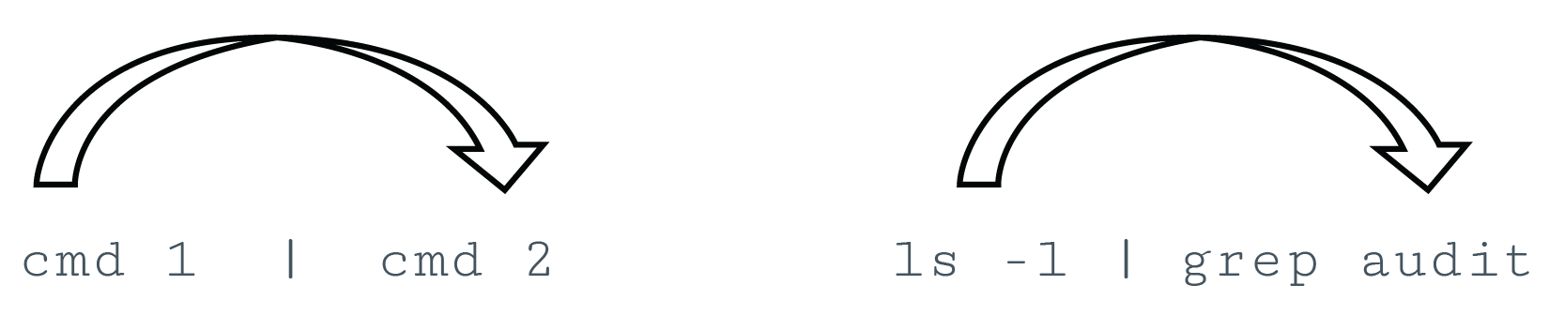
Piping
The process of combining the standard I/O streams of commands.
Standard output of one command is used as standard input for another.
Output format of first command should be compatible with second.
Pipe operator (|) can be used with most Linux commands.

Slide 105
The xargs Command (Slide 1 of 2)
Reads from stdin and executes command for each argument provided.
Argument must be separated by blanks.
Pipe makes output of first command the input for second command.
Commonly used with find command.
Operate on each result of a file/directory search.
Notes:
Teaching Tip: lConsider pointing out that the "x" in xargs refers to the mathematical variable.

Slide 106
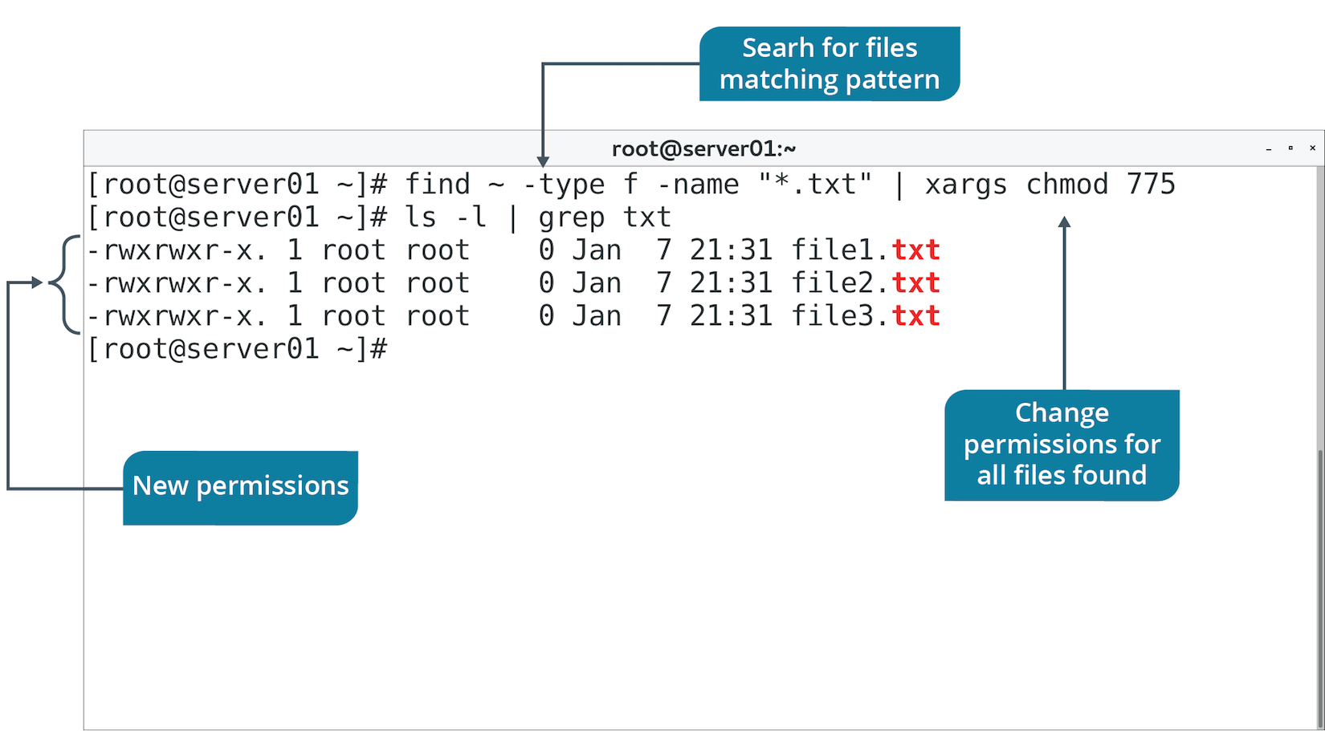
The xargs Command (Slide 2 of 2)

Slide 107
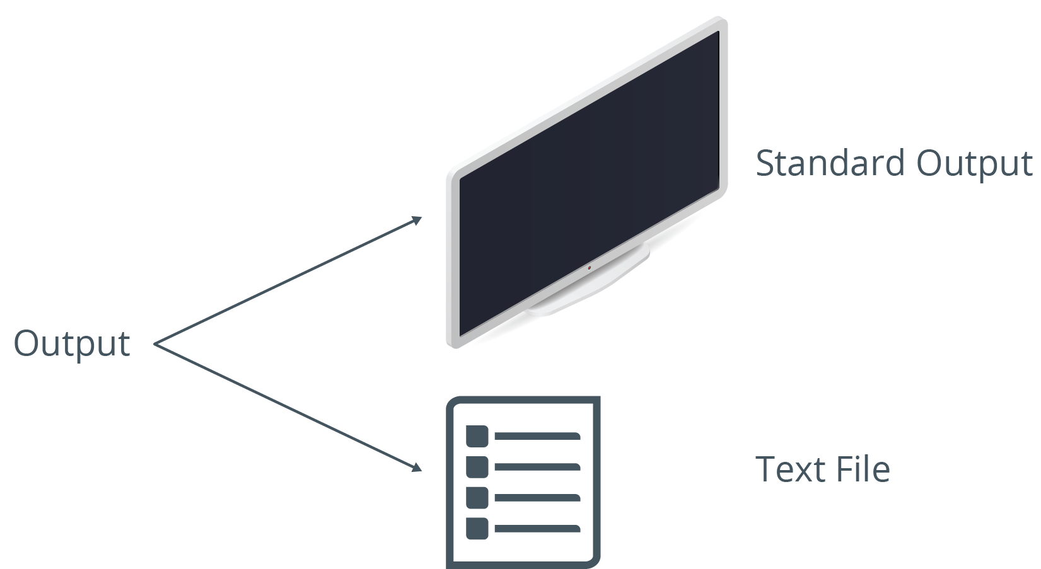
The tee Command
Reads stdin, sends output to CLI, and copies output to specified files.
You can verify command output now and store it in a file for later.
Accepts input from another command using a pipe.
The -a option appends to file instead of overwriting.

Slide 108
The /dev/null File
A file that discards all data written to it.
Also called the null device.
You can redirect output to this file to:
Confirm output was successful.
Not actually write data.
Useful in testing commands, scripts, etc.
Also useful in suppressing error info in commands.
Redirect error output (2>) to /dev/null file.

Slide 109
Terminal Redirection
A running process can be controlled by a terminal.
Multiple terminals can run at once.
Each terminal is assigned an identifier.
Usual format is /dev/tty#
You can redirect stdin and stdout to controlling terminals.
Reference its /dev/tty number.
Useful for redirecting text streams between processes.

Slide 110
Discussing File Output

Slide 111
Activity 5-12: Discussing File Output
How would you create a file with the following content using a single command? Note that each component should be on its own line (a total of three lines), like addressing a letter in the mail: Bob Jones 222 Main Street Dallas, TX
ANSWER:
printf "Bob Jones\n222 Main Street\nDallas, TX" > bob.txt

Slide 112
Activity 5-12: Discussing File Output
Why does the following command send the name Sally Davis to the sally.txt file? echo "Sally Davis" > sally.txt
ANSWER:
Because the echo command, coupled with the redirect operator (>), redirects stdout, Sally Davis, to the sally.txt file.

Slide 113
Activity 5-12: Discussing File Output
Your manager asks you to find the number of times that connections from IP address 10.0.10.5 have connected to server1. These events are typically logged in the /var/log/auth.log file. Using piping, how can you get this count for him?
ANSWER:
sudo grep 10.0.10.5 /var/log/auth.log | wc –l —This command searches for the string "10.0.10.5" in the authentication log and then pipes the output to the word count utility by the number of lines.

Slide 114
Activity 5-12: Discussing File Output
What does the following command do? cat file.txt > /dev/null
ANSWER:
Anything redirected to /dev/null has no output. It isn't saved to a file or displayed to the screen. It is sent to the null device.

Slide 115
Activity 5-12: Discussing File Output
What happens if you issue the following command? mail bbates@domain.com < addresses.txt
ANSWER:
The addresses.txt file's contents will be mailed to bbates@domain.com.

Slide 116
Activity: Manipulating File Output
IT keeps an inventory of issued laptops.
You need to move info to a Linux server.
Source isn't formatted very well.
You'll create a new file, fix its mistakes, and then sort it.
You also want to check the backup directory.
Use tee to see results at CLI and output to a file.
You'll also use piping with grep to hone your log analysis skills.
Notes:
Teaching Tip: The following steps are meant to simulate output redirection, and are not necessarily real-world examples.
Teaching Tip: If students are curious, the sudo results in this step are just the records of them performing the search with superuser privileges.

Slide 117
What are some ways that leveraging the power of text streams and standard I/O could enhance your administrative tasks on Linux systems?
Which Linux text editor do you prefer to use? Why?

